Slide 1

Basic Details of the Team and Problem Statement
Ministry/Organization Name/Student Innovation: Ministry of Textiles
PS Code: 1309
Problem Statement Title: Application development for the monitoring of Wool from Farm to Fabric
Team Name: IMPACT INITIATORS
Team Leader Name: SIYA Institute Code (AISHE): C-29461 Institute Name: CGC-COE
Theme Name: Transportation and Logistics

Slide 2
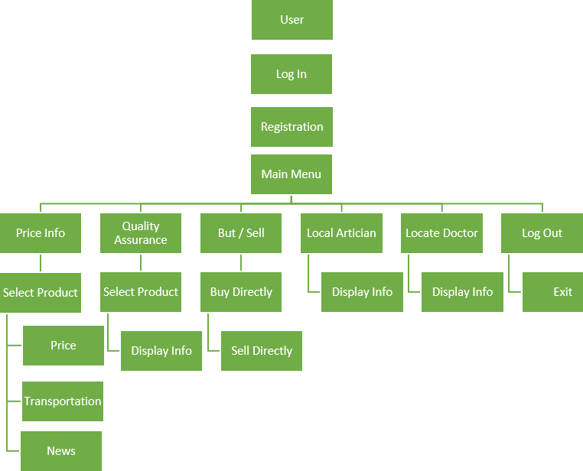




FLOWCHART:
Idea/Approach Details
● Providing login and registration page for farmer and buyer.
● Registration of buyer with username , password and email id.
● Registration of farmer will be same as buyer also have too.
provide UPRN(Unique permanent registration number) it use
to track the data so that quality of production increased by
using that data
● Buyer can get information related to type of wool, design,
price ,quality ,transportation charge.
● Payment should be transferred directly into the bank
account of farmer after successfully uploading the detail.
● Site containing information regarding availability of doctors in
the nearby locality for sheep diagnosis.
● Availability of wool artisans in the locality for farmer to
improve their production.
● Farmer and buyer can get latest information and market
trend about wool on the software.
● This is a community based software were people working in
the wool sector can come together on this platform to
collaborate and conduct business with each other
T echnolog y stack:
PYTHON

Slide 3
Idea/Approach Details:
Dependencies / Stoppers :
USED CASES
DEPENDENCIES :
Technical infrastructure : A stable technical foundation is required.
Farmer : A lack of farmer using this application will not provide accurate data to govt
STOPPERS:
Data accuracy: Data accuracy is one of the major stopper as inaccurate or incomplete information can lead to unintended consequences.
Monetization: Determining the right revenue model, such as subscription fees, transaction fees, or advertising, is crucial to sustain your app's operations.
The development of an app based on wool sector is a prime step for the convenience of farmer and buyer.
User Accessibility : It will become easier for the user and the buyer to choose any type of wool or any pattern on fabric as per their choice for any location .
Data collection : This app will collect all the data regarding sheeps , no of farmer in SHG ( Self help group) ,buyers,the doctor available for sheep diagnosis in a particular locality and the transportation facilities .with the help of all this data
,government can take necessary steps for the improvement in any of these .
Accessible information : we prioritize accessibility,making every process information available to the farmer.

Slide 4
Team Member Details
Team Leader Name: SIYA
Branch : B.TECH | Stream : CSE | Year : II
Team Member 1 Name: TUSHAR
Branch : B.TECH | Stream : CSE | Year : II
Team Member 2 Name: VISHANT RATHI
Branch : B.TECH | Stream :CSE | Year : II
Team Member 3 Name: VAIBHAV RATHOUR
Branch : B.TECH | Stream: CSE | Year : II
Team Member 4 Name: VANSHIKA SHARMA
Branch : B.TECH | Stream : CSE | Year : II
Team Member 5 Name: VISHAKHA DHIMAN
Branch : B.TECH | Stream : CSE | Year : II
Team Mentor 1 Name: DR.HIMANI CHUGH
Category : Academic | Expertise : AI, ML, Blockchain, Image processing | Domain Experience (in years): 18 years

